Slide 1
Introduction

Slide 2
Text Search Engine(A Prototype)
Aim –
The aim of this project is to build a prototype of a search engine which will work on millions of wikipedia pages (which are in xml format) and retrieves the top 10 relevant Wikipedia documents that matches the input query.
This takes Wikipedia corpus in XML format which is available at Wikipedia.org as input. Then it indices millions of Wikipedia pages involving a comparable number of distinct terms.
Then given a query, it retrieves relevant ranked documents and their titles using index.

Slide 3
Exact values vs. full text search
Search can be categorized into 2 ways:-
Exact value
Full text
Exact value search
Full text search
Example- Exact value F00 is not the same as foo. The value 2014 is not the same as 2014-12-03.
Exact values are easy to query. The decision is binary, a value either matches a query or it does not.
Ex:- where name = “soham” and user_id=1;
Querying full text data is much more subtle . We are not asking “Does this document match the query?” but “How well does this document match the query?”. Means how relevant is this document to the query.
Not ‘yes’ or ‘no’ or binary answers.

Slide 4
Analysis and Analyzers

Slide 5
Inverted Index
To facilitate full text search, in our project we first analyze the text and use the result to build inverted index.
An inverted index contains all the unique words that appear in any document, and for each word,
a list of documents in which it appears.
To create inverted index, we first split the content field of each document into separate words(which we call tokens),create a sorted list of all the unique terms, and then for each term we maintain a list of documents in which it is present.
Given input will be in XML format.
Need to understand in this XML file where content is present.
Get into the content and do various preprocessing on it.
Once preprocessed the entire text(1 page) is now converted into many tokens.
Now we are going to save all these words in a tabular form and for every word we maintain a list of pages in which it occurred.

Slide 6
Example
Term | Document 1 | Document 2
This | ✓ | ✗
is | ✓ | ✓
text | ✓ | ✗
search | ✓ | ✗
engine | ✓ | ✗
The | ✗ | ✓
prerequisite | ✗ | ✓
for | ✗ | ✓
doing | ✗ | ✓
good | ✗ | ✓
work | ✗ | ✓
motivation | ✗ | ✓
Consider following documents:-
Document 1-This is text search engine.
Document 2- The prerequisite for doing good work is motivation.
Delete Stop Words
Tokenize
Stemming
Maintain Indexing
For millions of documents if we maintain inverted indexing,
we will go for multi-level indexing, so as to direct the search accordingly.

Slide 7
Text Preprocessing
Tokenization
White Space Tokenizer
Penn Treebank Tokenizer
Sentence Segmentation – mark the sentence ending
Case Folding – ex: if user types ‘ravi’ in small or capital letters ,he mean the same thing i.e., we need to understand and converge words having same root meaning
Removing Stop Words – ex: is, a, an, the etc., are really not important coming to search
Stemming – ex: obtaining root word from given word
Porter Stemming Algorithm(Implemented)
Lancaster Stemming Algorithm
WordNet Lemmatizer

Slide 8
Tokenization
White space tokenizer
Ex:- Dr. Srikant Varma still has possession of his ill-gotten goods; his brother’s assets and liabilities.
#tokens = 15
If we tokenize based on all characters other than alphabets(A-Z, a-z)
Ex:- Dr Srikant Varma still has possession of his ill gotten goods his brother s assets and liabilities
#tokens = 17

Slide 9
Issues in Tokenization
India’s capital →→ India Indias India’s?
We’re, I’m, aren’t →→ We are, I am, are not?
Ill-gotten →→ Ill-gotten, Ill gotten?
Srikant Varma →→ single token or two?
U.S.A →→ USA or U.S.A
Special characters and number formats $35.40 , $50.75
Penn Treebank Tokenizer(a standard defined by linguistic Data consortium(LDC)) will answer all these questions

Slide 10
Penn Treebank Tokenization
A standard released by Linguistic Data Consortium.
It seperates out clitics.
Keeps hyphenated words together.
Seperates out all punctuations.
Ex:- India’s capital – India s
Ex:- “ Has anything escaped me ? ” I asked with some self-importance . “ I trust that there is nothing of consequence which I have overlooked ? ”
#Tokens = 28
doesn’t → does n’t
can’t → ca n’t
haven’t → have n’t

Slide 11
Case Folding
For tasks like speech recognition and information retrieval, everything is mapped to lower case.
So we might sometimes loose meaning of acronyms.
JADAVPUR ➔ jadavpur
US ➔ us
Fox
While searching for fox, user has typed Fox.
fox
Inside this document there is this word.
There is a chance that our engine will say that this document is not containing this word.
To maintain consistency convert all these words into single case(small case).

Slide 12
Java Code to Implement Whitespace Tokenization
Tokenizing using OpenNLP
The opennlp.tools.tokenize package contains the classes and interfaces that are used to perform tokenization.
To tokenize the given sentences into simpler fragments, the OpenNLP library provides this class
WhitespaceTokenizer − This class uses whitespaces to tokenize the given text.
To tokenize a sentence using the WhitespaceTokenizer class, we need to −
Create an object of the respective class.
Tokenize the sentence using the tokenize() method.
Print the tokens.

Slide 13
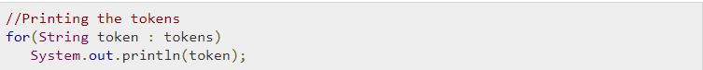
Following are the steps to be followed to write a program which tokenizes the given raw text.
Step 1 − Instantiating the respective class
In both the classes, there are no constructors available to instantiate them. Therefore, we need to create objects of these classes using the static variable INSTANCE.
Step 2 − Tokenize the sentences
Both these classes contain a method called tokenize(). This method accepts a raw text in String format. On invoking, it tokenizes the given String and returns an array of Strings (tokens).
Tokenize the sentence using the tokenizer() method as shown below.
Step 3 − Print the tokens
After tokenizing the sentence, you can print the tokens using for loop, as shown below.

Slide 14
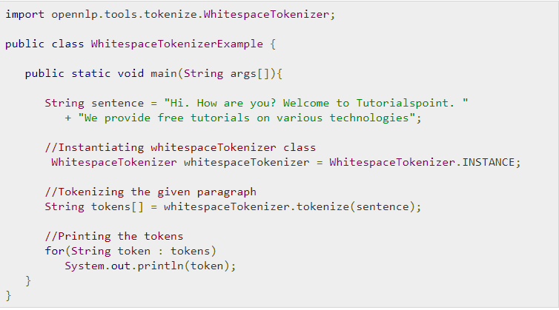
Example
Following is the program which tokenizes the given sentence using the Whitespace Tokenizer class.
Compile and execute the saved Java file from the Command prompt using the following commands −

Slide 15
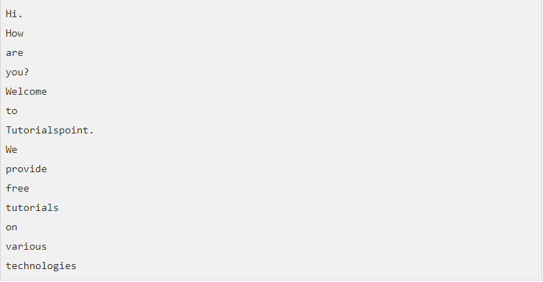
On executing, the above program reads the given String (raw text), tokenizes it, and displays the following output -

Slide 16
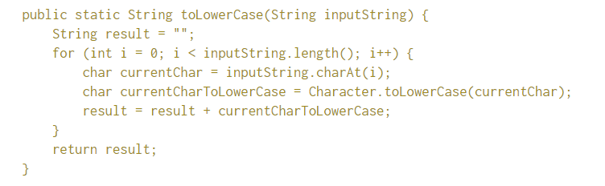
Java Code to Implement Case Folding on a given sentence
Lower Case : The conversion of a String to lower case is similar to upper case except that we change each of the letter to its lower case form. Toggle Case : Small letters a-z are converted to capital letters A-Z and vice versa.
We would be using length() and charAt(int) methods of the String class. The length() method returns the numbers of characters that the String contains. The charAt() method takes an integer argument and returns the character contained at that integer index.
The Character class contains a number of static methods which can be used to test whether a character is upper case or lower case and also convert between the two forms.

Slide 17
XML(Extensible Markup Language)
XML tags identify the data and are used to store and organize data rather than how to display like the HTML tags.
Characteristics of XML
Extensible:- XML allows us to create our own self descriptive tags, or language that suits our application.
XML carries data, does not present it.
XML is public standard.

Slide 18
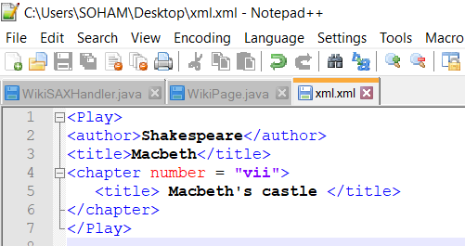
Sample XML Template
Root element Play
Author
Text Shakespeare
title
Text Macbeth
Chapter
title
Text Macbeth’s castle

Slide 19
DOM Parser to read XML file in Java
Document Object Model (DOM) API for XML approach is memory intensive compared to the SAX parser. If XML content size is large it is recommended to use the SAX parser approach. In the DOM parsing approach we load the entire contents of an XML file into a tree structure and then iterate through the tree to read the content.
Typically when we need to modify the XML documents DOM parser would be advantageous.
A sample implementation of DOM parser is listed below. Here we read the XML file and create a Document object in memory. Then we iterate through the tree and extract the required elements/ attributes.

Slide 20
SAX Parser
SAX (the simple API for XML) is an event based parser for XML documents.
SAX is a streaming interface for XML, means the application using SAX receives event notifications about the XML document being processed, an element and attribute at a time in sequential order starting at the top of the document.
Reads an XML document from top to bottom , recognizing the tokens that make up a well formed XML document. Tokens are processed in the same order that they appear in the document.
Application program provides an “event” handler that must be registered with the parser.
SAX will parse the document and depending on token, it will call the methods in the handler.

Slide 21
Content Handler Interface
void startDocument():- Called at the beginning of a document.
void endDocument():- Called at the end of a document.
void startElement(string uri, string localName, string qName, string Attributes atts):- Called at the beginning of an element.
void endElement(string uri, string localName, string qName):- Called at the end of an element.
void characters(char[] ch, int start, int length):- Called when character data is encountered.

Slide 22
Why SAX Parser
Other parsers try to bring entire XML document into the memory and then parse it and create a constructive parse tree. SAX parser reads XML document streamwise(byte by byte)

Slide 23
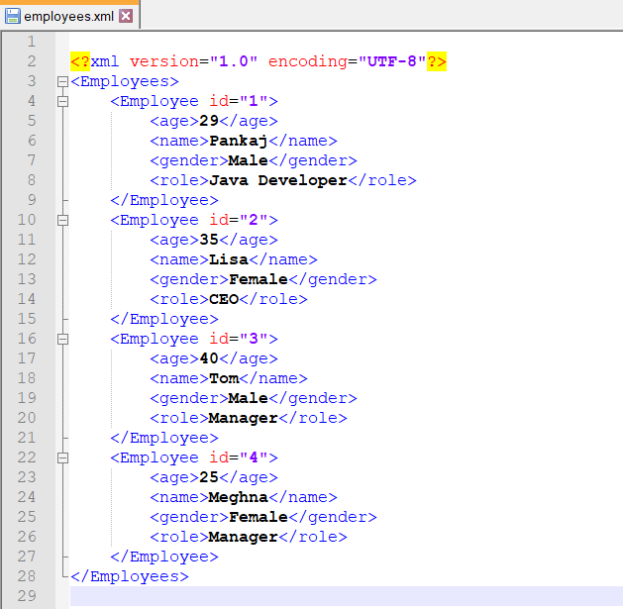
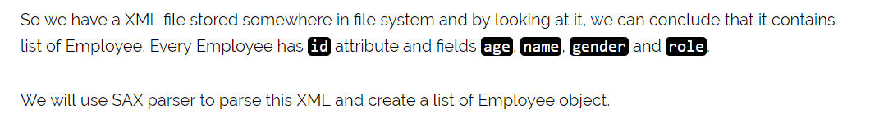
SAX Parser Example

Slide 24
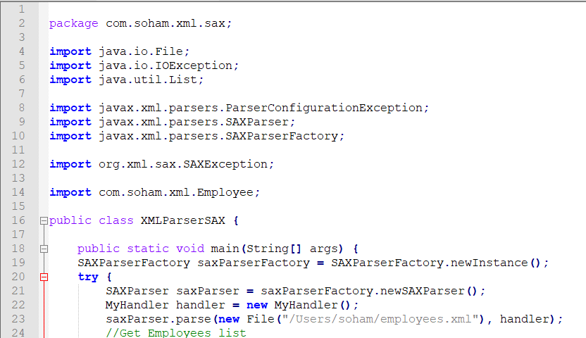
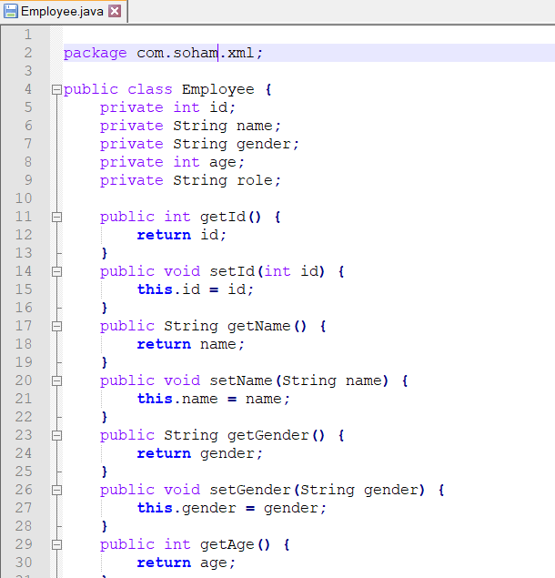
Attributes
Creating a SAX parser

Slide 25
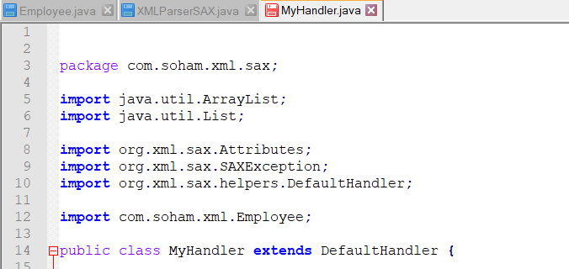
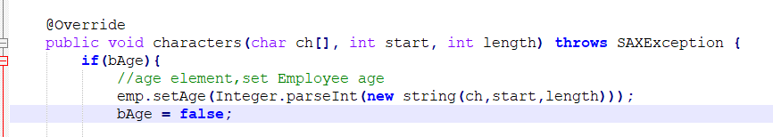
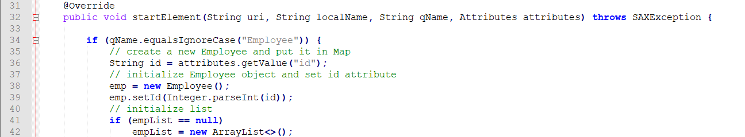
We know when we extend a class we get all the attributes of the class and methods with an option to overwrite some methods.
Earlier if this is true, it will read age, parse into Int.(string),employee is going to set age. After setting age Boolean will be turned to false to make it usable for the next time.
We know employee id, so convert this string into integer number.
If this is the first employee created, we want a list of employees so that we can keep on adding to the list.
When an element starts SAX Parser calls ‘startElement’
Later we add this employee to newList

Slide 26
High Level Design
Module 1:-
Wikipedia Dump(contains set of pages)
Aim- Create wikipage object out of Wikipedia xml document
Create Wikipage object
The text attributes we are interested in:-
Title
Infobox(summary)
External Links(links to other pages)
Category
Text Content

Slide 27
High Level Design
Module 2:-
Consider a wikipage
Step 1- Split the text into tokens
Step 2-Remove stop words
Step 3- Stem the word
Step 4- Maintain count where each word occurred(Maintain Hashmap)
Key | Value
Particular word | Integer[] {0,0,0,0,0}
Text
Title
Infobox
Category
External Links

Slide 28
High Level Design
Module 3:-
Build Inverted Index
Key | Doc List
Particular word | Docid1-setBit:tf(weight) Docid2-setBit:tf(weight)
If Inverted index size is too large, cannot fit in RAM , we dump it in the Hard Disk.(with sorted words)

Slide 29
High Level Design
Module 3:-
RAM
HD
HD
Key | Doc List
Particular word | Docid1-setBit:tf(weight) Docid2-setBit:tf(weight)
Key | Doc List
Particular word | Docid3-setBit:tf(weight) Docid4-setBit:tf(weight)
Key | Doc List
Particular word | Docid5-setBit:tf(weight) Docid6-setBit:tf(weight)

Slide 30
High Level Design
Term Frequency
Is a numerical statistic that is intended to reflect how important a word is to the document in a collection(or) corpus.
Ex:- Consider a query “borrow” and we wish to determine which documents are relevant to the query.
Approach 1:-Eliminate all documents that do not contain “borrow”.
Above still leaves many documents .
Solution- Count the number of times each term occur in each document.

Slide 31
How to calculate
Term Frequency
Title | Infobox | Links | Category | Body
A particular word
1, 3, 0, 1, 5
weight
1000 | 20 | 10 | 50 | 1
Total weight = 1*1000+3*20+0*10+1*50+5*1=1115
Term Frequency = 1 + log(total weight) = 1 +log(1115)= 4.047
Key | Doc List
Particular word | Docid1-setBit:tf(weight) Docid2-setBit:tf(weight)

Slide 32
External Sorting
It is a class of sorting algorithm that can handle massive amounts of data.
External sorting is required, when the data being sorted do not fit in to the main memory and instead they must reside in the slower external memory.
One example is External merge sort
Which sorts chunks that fit in RAM.
Then merge the sorted chunks together.
First divide the file in to runs such that size of run small enough to fit in to main memory.
Sort each run by using merge sort algorithm
Finally merge runs together into successively bigger runs, until file is sorted.

Slide 33
External Sorting(An example)
10,5,7,8,25,30,4,1,100,26
Big File
10,5,7,8,25
30,4,1,100,
26
Smaller Runs
Smaller Runs
sorted
5,7,8,10,25
1,4,26,30,
100
sorted
1,5,7,8,10,25,26,30,100
merged

Slide 34
High Level Design
Module 4:-
Merge the sub-index files(using external sort)
File 1
Key | Doc List
Particular word | Docid1-setBit:tf(weight); Docid2-setBit:tf(weight);
File 2
Key | Doc List
Particular word | Docid1-setBit:tf(weight); Docid2-setBit:tf(weight);

Slide 35
High Level Design
Disadvantages with term frequency
Consider a query ‘the brown’.
Because the term “the” is so common, term frequency tend to incorrectly emphasize document which happen to use “the” more frequently.
Solution-
(Inverted document frequency):-
Which diminishes the weight of terms that occur very frequently in the document set and increases the weight of terms that occur rarely.
idf = log(total number of docs/Number of docs in which the word has
occurred)

Slide 36
Final index contain:-
Key | Doc List
Particular word | Idf #docid1-setBit:tf(weight); docid2-setBit:tf(weight); docid3-setBit:tf(weight);
How frequent the word has occurred in all the documents.
So given one time.
How frequent the word has occurred in that particular document.
So required for every document.

Slide 37
How a wiki-page xml file looks like…

Slide 38
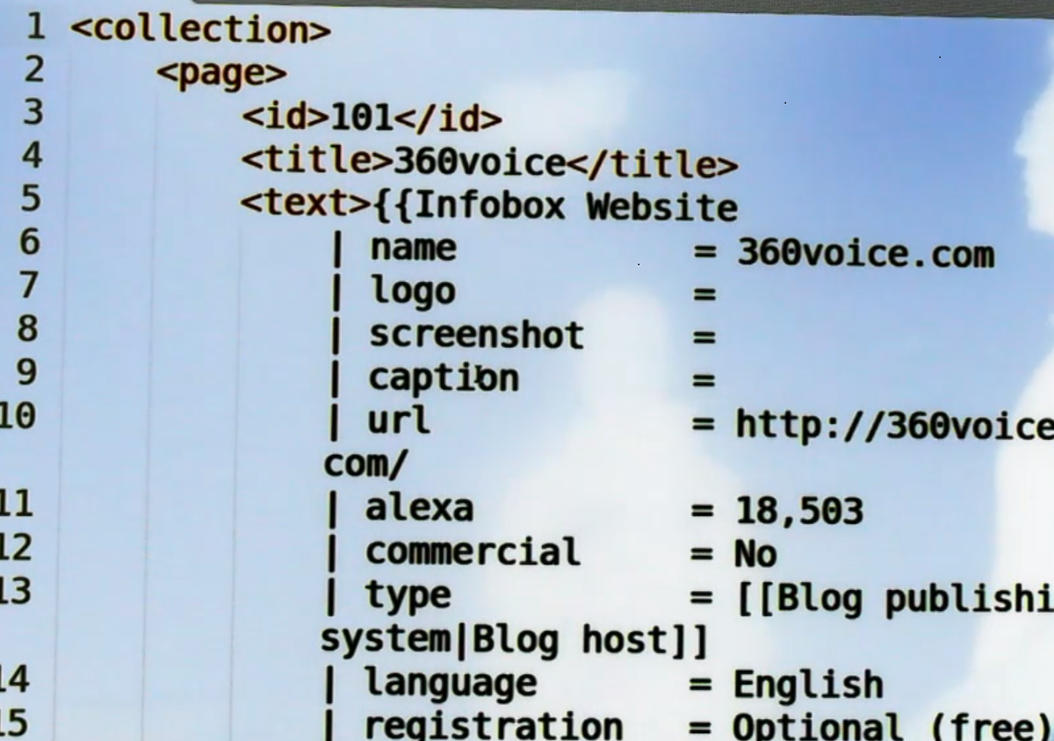
ID is almost like page number.
Infobox gives almost every detail
Who is owner
When did it start
Page rank
Alexa rank
……..
Starts with two curly braces inside text tag

Slide 39
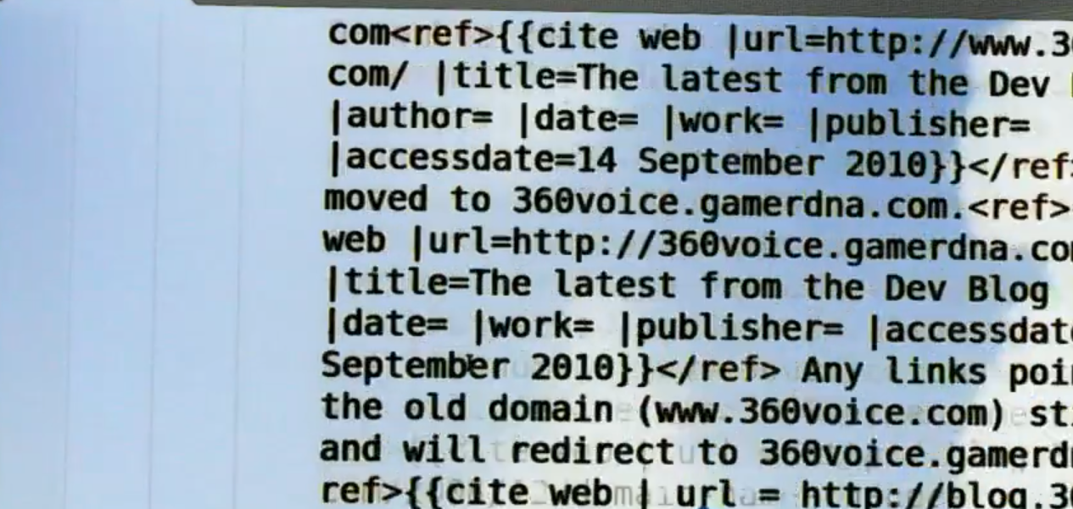
Text

Slide 40
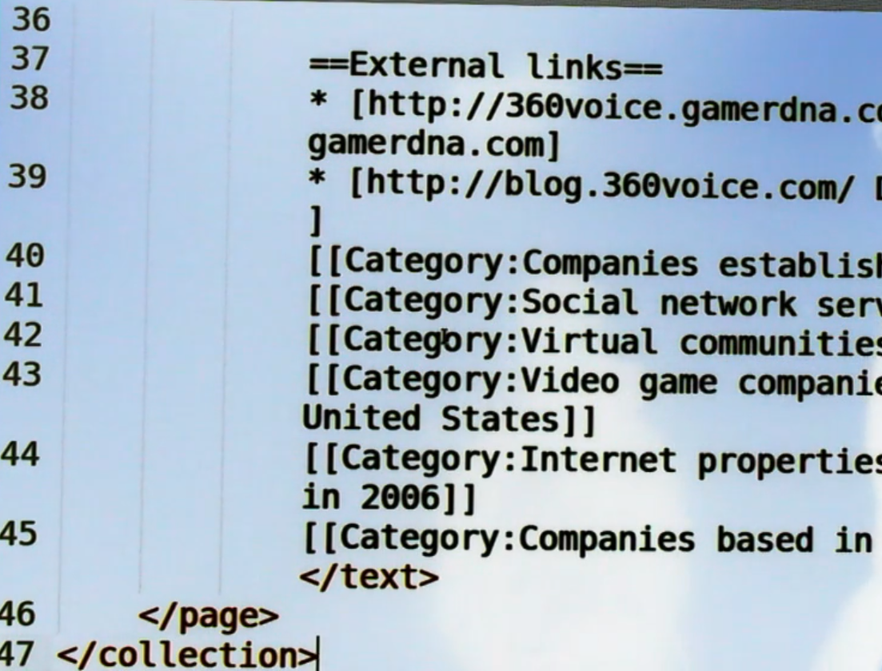
Every Wikipedia page will have some links to other pages.
A page may fall under various categories.

Slide 41
Implementation of Module 1

Slide 42
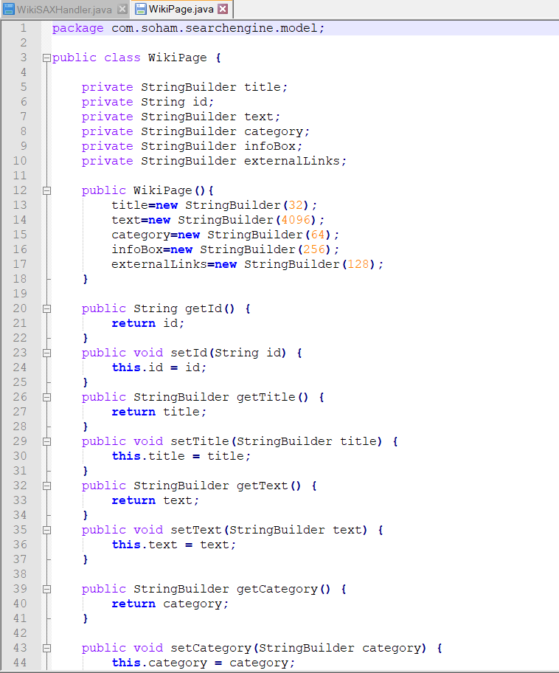
For every wikipage we need to build a “WikiPage” object and inside the object these are things I need to store and do processing upon.

Slide 43
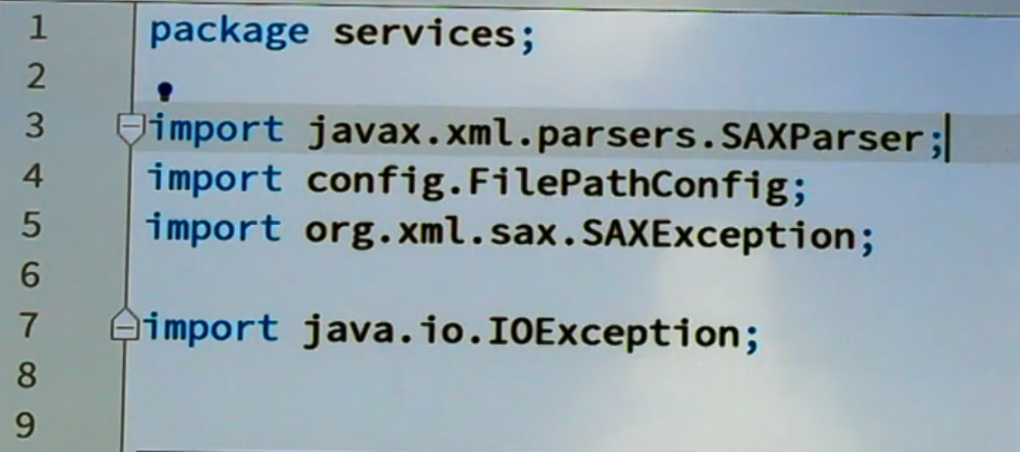
We are using SAX Parser
SAX-Simple API for XML Parsing

Slide 44
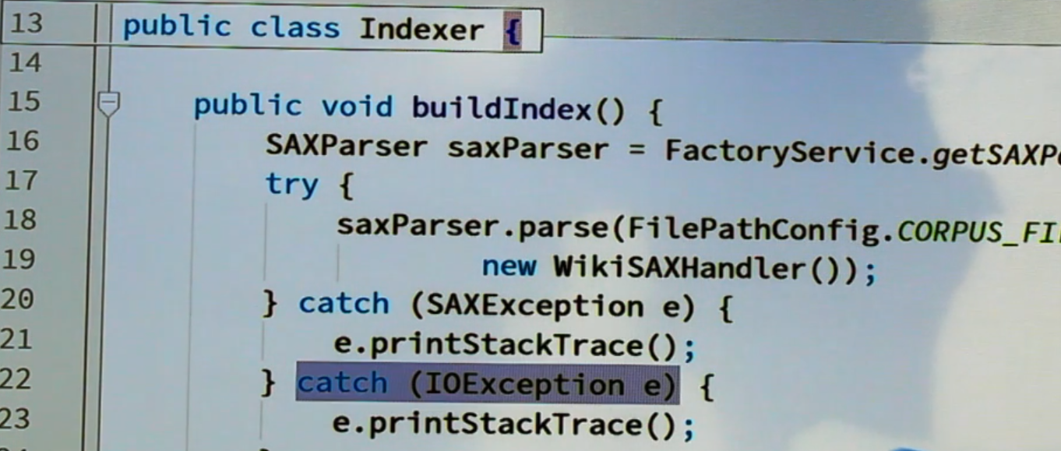
From Factory service we have to get SAX Parser
Input file or corpus file
Along with it we create a WikiSAXHandler following the standard prototype.
Create object saxParser
Calling the method ‘parse’ in object ‘saxParser’

Slide 45
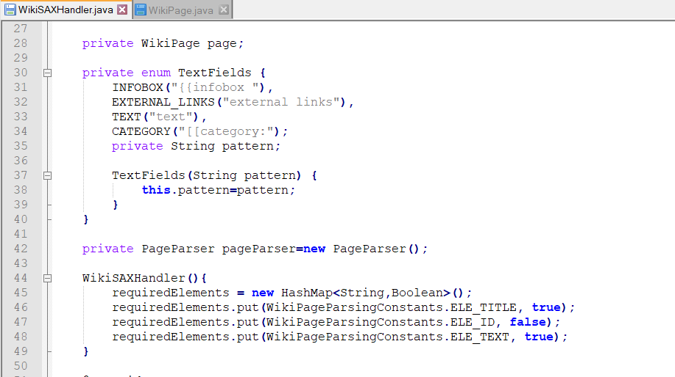
A hashmap into which we store what are the elements that we need to parse like Title, Text & id.

Slide 46
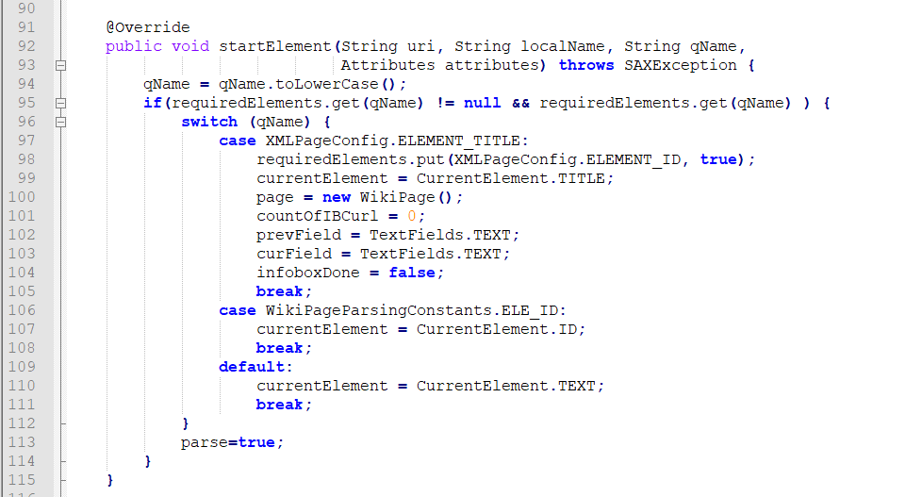
This snippet of code is for whenever an element has started we check whether it is one of the required element or not.
Storing element in ‘qName’ and checking whether it is the required element.
Now current element is nothing but title.
If element is ‘TITLE’ it means a new page has started ,so create a new WikiPage.
In that wikipage we put whatever the title is.
Once that element has occurred we don’t want to see one more title element ,so making it false.
Assuming that after title only ID and text will come and title is always the starting element in all the Wikipedia pages.

Slide 47
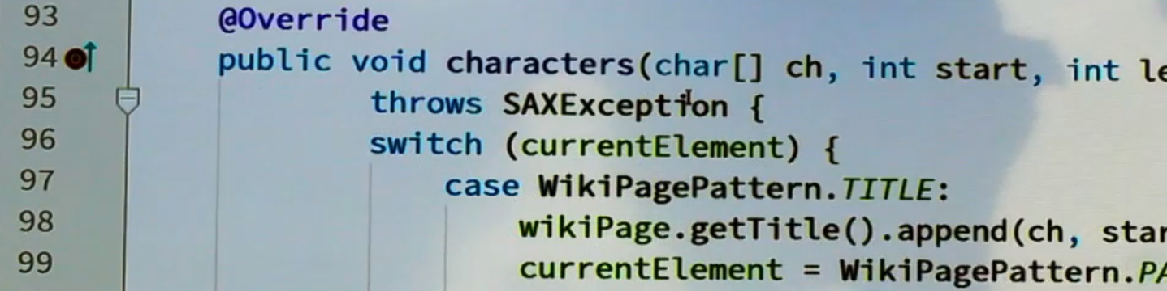
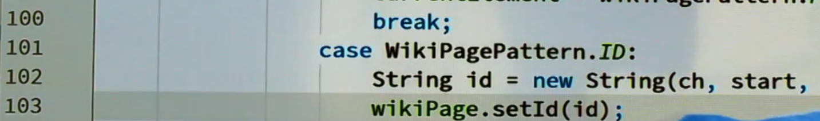
Depending on the current Element if it is a TITLE Tag (say) , the data structure stringbuilder ‘TITLE’ present inside the ‘WikiPage’ will now get whatever is present inside the ‘TITLE’ tag.
Similarly Wikipedia page string ID will get particular string.

Slide 48
Implementation of Module 2

Slide 49
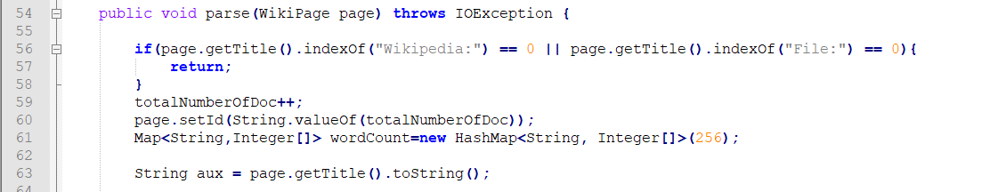
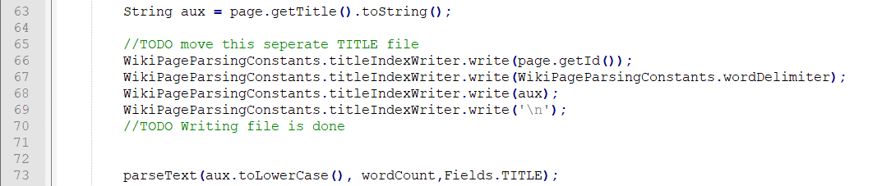
Counting the total number of documents.
Sometimes if document id is not present in document count it ourselves and giving that number as the document ID.
Every string is mapped to integer array.
Wikipage object
Get the info present about title which is a stringbuilder
Converted into string
Method to parse string

Slide 50
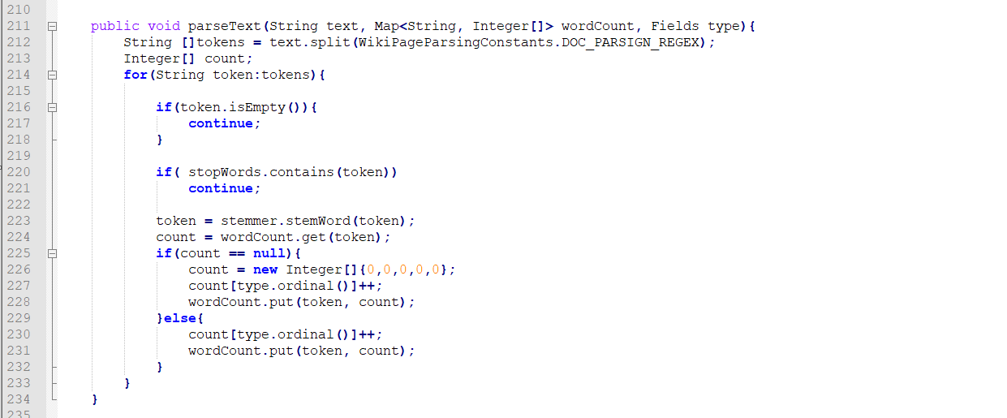
parseText method

Slide 51
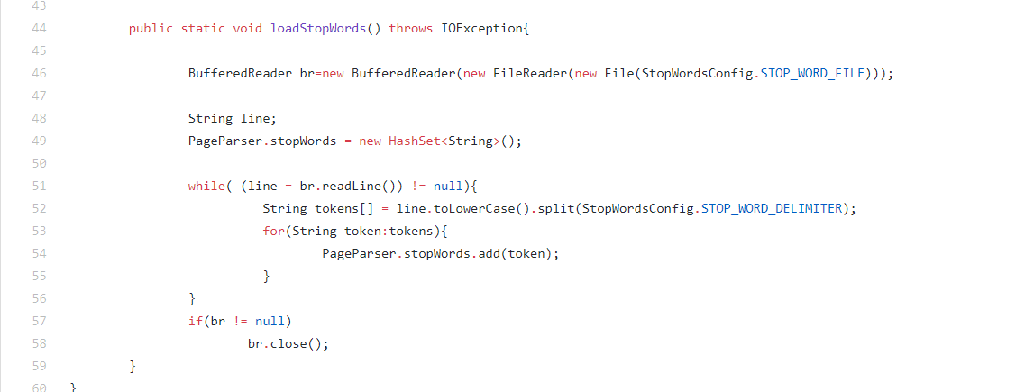
Loading Stopwords

Slide 52
Module 3-Implementation Overview

Slide 53
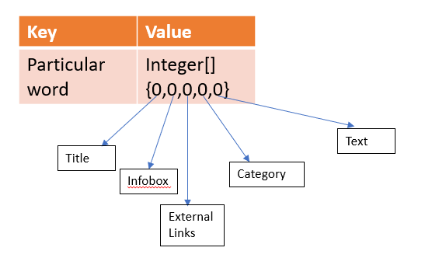
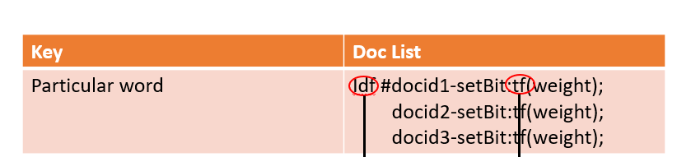
Module 3-
Wikipage1 XML
Wikipage Object
WordCount
Wikipage2 XML
WikipageN
XML
Wikipage
Object
Wikipage Object
WordCount
WordCount
…..
Hashmap
Every WordCount Hashmap is written in to Treemap
TreeMap(allWords)
TreeMap(allWords)
If RAM is full, we will flush this treemap to Hard Disk.

Slide 54
Building a Inverted Index

Slide 55
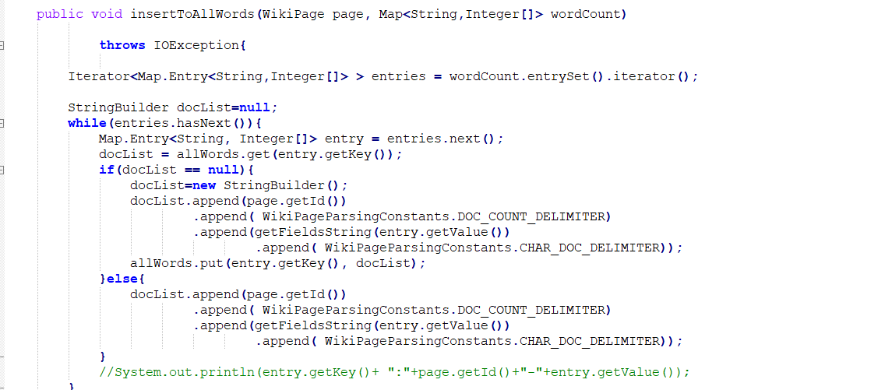
Contains the Information about the collection of all documents in which this particular word has occurred.
Going to append DocId
Going to append SetBit
Going to append Term Frequency
Put it in allWords.

Slide 56
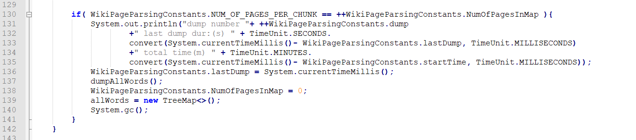
Pages are divided into chunks , for each chunk we are going to have a treemap.
Delete the old tree map if it is present in old memory.

Slide 57
Pages are divided into chunks , for each chunk we are going to have a treemap.
Delete the old tree map if it is present in old memory.

Slide 58
Calculating Term Frequency

Slide 59
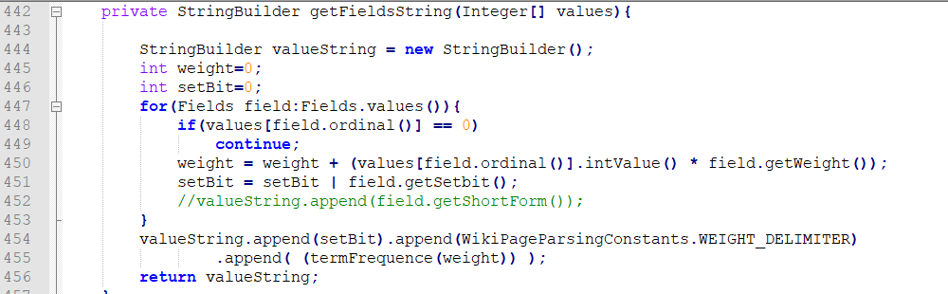
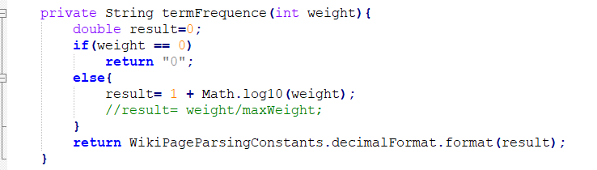
Take each number from integer array and attach weights to it which are configurable.
Just checks if a word has occurred in particular category or not using a simple ‘OR’.
Creating a stringbuilder and appending wt. and tf. Whatever is returned is being used in the other methods to form key-value pair for the final treemap

Slide 60
Merging external offset files

Slide 61
Word = docid_Setbit:weight(tf);
A word as a key
File2
Good#idf=12_5:3000;7_5:2000;15_9:1300;3_4:20;
Good=3_4:20;7_5:2000;
Good=12_5:3000;
Good=15_9:1300;
File1
File3
7_index.txt
External sorting is used.(merge procedure)

Slide 62
Calculating idf:-
Math.log((double)totalNumberdocs/numberofdocs.word_present)

Slide 63
Internals of Merging

Slide 64
Priority Queue
File_1
File_2
File_n
subindexfiles
……
getNextline
Readers used
0_index.txt
1_index.txt
25_index.txt
Writers used
……

Slide 65
Implementation of Merging

Slide 66
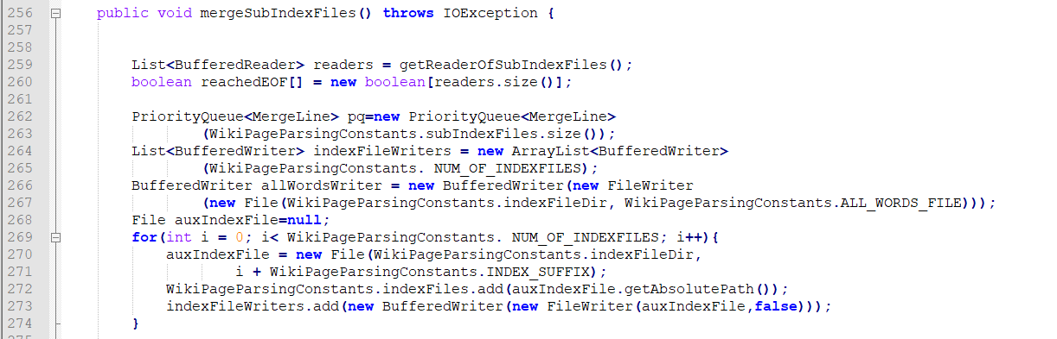
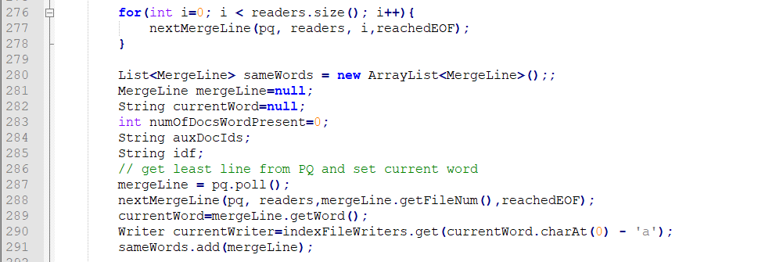
Associating readers with every sub-index files
Attaching a writer for all 26 index files.
Going to take 1 word from each sub-index files and add it to priority queue
Taking all words which are same, merge it and creating a same entry.

Slide 67
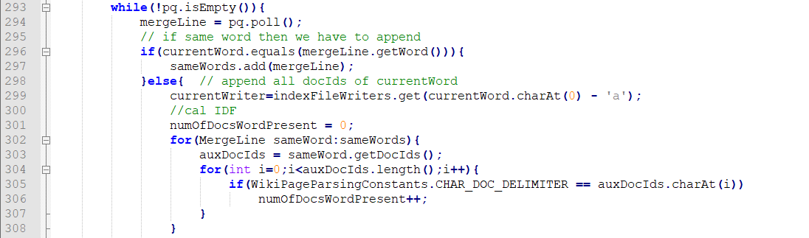
Whatever I have deleted from heap I will store it in currentWord.
Apart from creation of final index files we are also going to maintain a file in which we are going to record every distinct words once and the number of times it has occurred.

Slide 68
Creating secondary indexes to inverted indexes.

Slide 69
Creating indexes to inverted indexes:-
*_secondary.txt
*_offset.txt
*_index.txt
Word1#lineStart
Word20#lineStart
Word#lineStart
Word#idf=[doc_id List]

Slide 70
Real Example:-
*4_secondary.txt
*4_offset.txt
*4_index.txt
earlier#0
Eval#52
0.earlier#0
10.edit#25
.
.
.
.
.
.
52eval#100
.
.
.
.
Evaluation#201
0earlier#03=2_1:1;3_1:1;
25edit#06=4_1:1;
.
.
.
.
.
100eval#05=10_12:13;
.
.
.
.
201evaluation#07=20_13:1;

Slide 71
Thank You

